Slide 1
Discrete Logarithms

Slide 2
Why do we study discrete logarithms ?
We need a numerical procedure which is easy in one direction, but difficult in other direction.
For example,
5⁵ mod 17 = ?
5^{X} mod 17 = 12
Easy
Difficult

Slide 3
Discrete logarithm
If a is an arbitrary integer relatively prime to m and b is a primitive root of (mod m) then there exist exactly one number i such that a = b^{i} (mod m).
The number i is called the distinct logarithm of a with respect to the base b modulo m and it is denoted as ,
i = log_{b}ª (mod m)
(or)
i = dlog_{b,m} (a)
m = prime , a = relatively prime to m , b = primitive root of (mod m) , i = any integer

Slide 4
Primitive root
If b is a primitive root of (mod m) where m is prime number the b¹(mod m), b²(mod m), b³(mod m)..............b^{m-1}(mod m), are distinct.
For example,
5³ mod 13 = 8
5⁷ mod 13 = 8
5¹¹ mod 13 = 8
Here the value of a is same for different values of a, so 5 is not a primitive
root of 13

Slide 5
Example of primitive root
5¹ mod 17 = 5
5² mod 17 = 8
5³ mod 17 = 6
5⁴ mod 17 = 13
5⁵ mod 17 = 14
5⁶ mod 17 = 2
5⁷ mod 17 = 10
5⁸ mod 17 = 16
5⁹ mod 17 = 12
5¹⁰ mod 17 = 9
5¹¹ mod 17 = 11
5¹² mod 17 = 4
5¹³ mod 17 = 3
5¹⁴ mod 17 = 15
5¹⁵ mod 17 = 7
5¹⁶ mod 17 = 1
Here all the elements are distinct so 5 is a primitive root of 17.

Slide 6
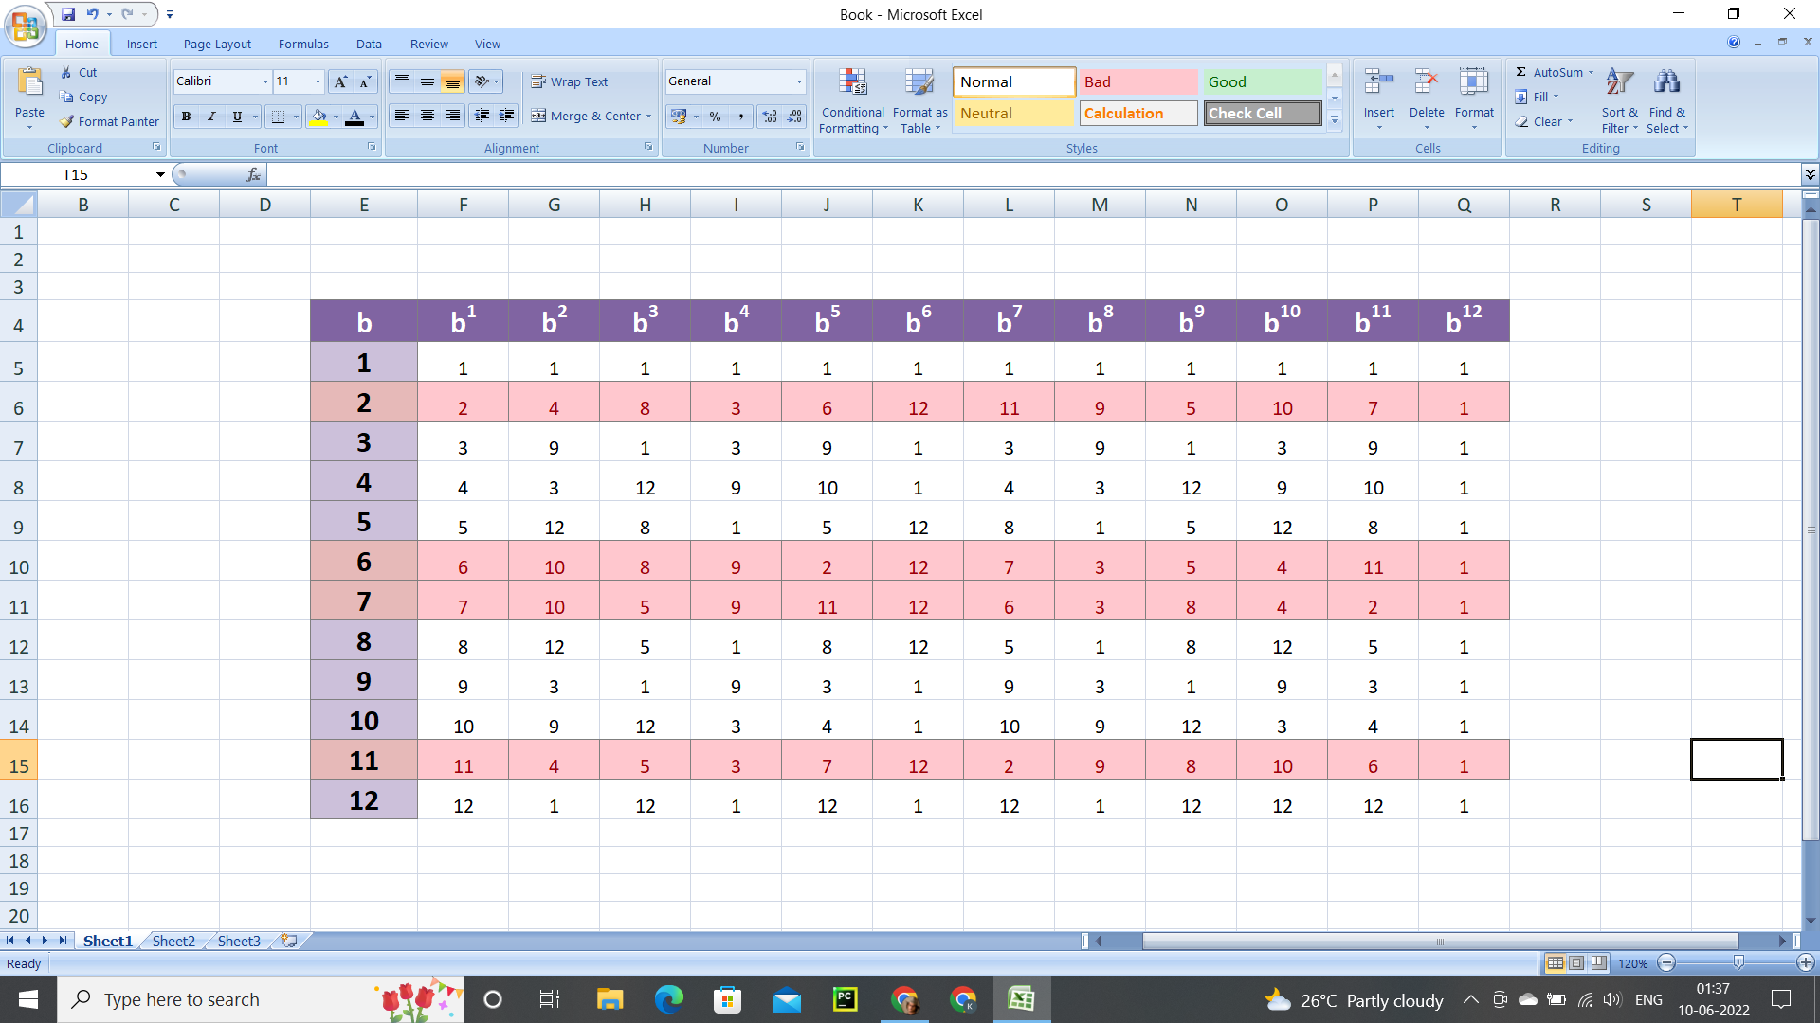
To find the primitive root a = b^{i} (mod m) for m = 13
Hence 2,6,7,11 are primitive roots of modulo 13

Slide 7
Solve log₂9(mod 11)
Let p = 11, g = 2, x=9
log₉x n ( mod p )
x = g^{n} (mod p)
9 = 2^{n} (mod 11)
Try ‘n’ = 1,2,3,....
9 = 2⁶( mod 11)
Ans = 6

Slide 8
.

